Slide 1


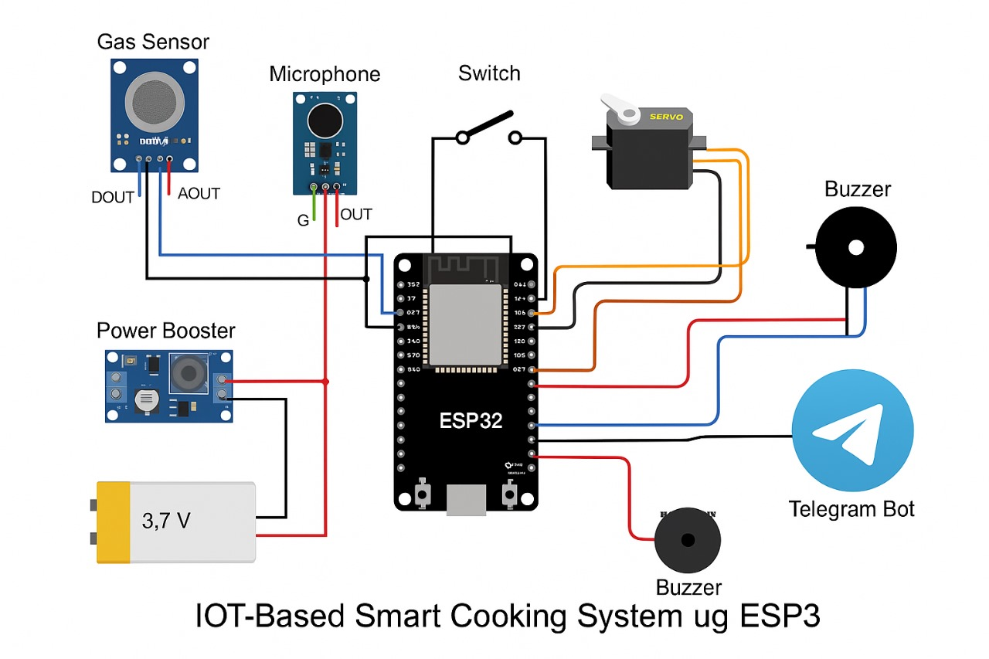
SANJIVANI UNIVERSITY
School of Engineering & Technology
Department of Artificial Intelligence & Data Science
IOT-Based Smart Cooking System
Problem Statement
Methodology
Results
Add your information, graphs and images to this section.
Add your information, graphs and images to this section.
Add your information, graphs and images to this section.
Cooking on a gas stove often requires constant attention, especially when using pressure cookers or boiling milk. Missing the exact number of whistles or leaving boiling milk unattended can lead to food wastage, spillage, or even fire hazards. Additionally, undetected gas leaks can cause dangerous situations, including suffocation or explosions. In today’s busy lifestyle, users may not always be able to monitor cooking closely. There is a strong need for a smart solution that automates basic cooking processes and alerts users remotely in case of any risk. This project aims to solve this problem by creating an IoT-based Smart Cooking System that automatically detects cooking events and gas leakage, turns off the gas when needed, and notifies the user via Telegram.
The Smart Cooking System is developed using a combination of sensors, a Wi-Fi-enabled ESP32 microcontroller, and a Telegram bot to implement automation and alert functionalities. The system operates in three core scenarios: whistle detection, milk boiling detection, and gas leakage detection.In the first scenario, a microphone sensor is used to detect the distinct whistle sounds of a pressure cooker. The ESP32 microcontroller processes the analog audio signals, filters the noise, and counts the number of pressure whistles. Once the system accurately detects three whistles, it triggers a servo motor to rotate and physically turn off the gas knob. Simultaneously, the system sends a notification to the user via a Telegram bot, informing them that the cooking has completed and the gas has been turned off.In the second scenario, the system monitors the boiling of milk. Upon detecting the start of the boiling process—either via temperature rise, increased gas sensor sensitivity, or acoustic changes—it initiates a three-minute timer. After the timer expires, it again activates the servo motor to turn off the gas. A Telegram message is sent to inform the user that the milk has boiled and the gas has been safely turned off.The third and most critical part of the system is gas leakage detection. An MQ-2 gas sensor is continuously used to detect the presence of LPG or other combustible gases in the air. If gas levels rise beyond a safe threshold, the ESP32 instantly activates a buzzer for an immediate local warning and sends an urgent alert message through the Telegram bot, warning the user of a potential gas leak.The entire system is powered by a rechargeable battery with a booster to ensure functionality even during power cuts, making it reliable in all situations.
The Smart Cooking System successfully automates cooking tasks and enhances safety. It accurately detects three whistles from a pressure cooker and turns off the gas using a servo motor. It also handles milk boiling by turning off the gas 3 minutes after boiling begins. The system reliably detects gas leakage and triggers both a buzzer and a Telegram alert. All notifications are sent in real-time, allowing users to monitor their kitchen remotely. The system is cost-effective iduals.
Objectives
Hardware
Technology used
Conclusion
Add your information, graphs and images to this section.
Add your information, graphs and images to this section.
Detect and count whistles using sound sensor.
Automatically turn off gas after 3 whistles.
Detect boiling milk and turn off gas after 3 minutes.
Detect gas leakage and rise buzzer & alert.
Notify the user using Telegram bot alerts.
ESP32 – Wi-fi enabled Microcontroller
Gas Sensor (MQ-2) – Detects LPG or gas leakage.
Microphone Sensor – Detects Whistle sound
Servo Motor – Mechanically turns off gas knob
Switch – Manual ON /OFF control
Buzzer – Sound alert in case of gas leakage
Telegram Bot – Sends alert message to the user
Embedded C programming
IOT (ESP32 with Wi-fi)
Telegram Bot API
Sensor Integration
The Smart Cooking System enhances kitchen safety and convenience by automating common cooking tasks using IoT. It reduces the chances of food burning, spillage, or gas leakage. This system is useful for households, hostels, and elderly individuals who may forget to turn off the gas.
References
Flores-Cortez, O., Cortez, R., & González, B. (2021). Design and Implementation of an IoT-Based LPG and CO Gases Monitoring System.
Narkhede, P., Walambe, R., Mandaokar, S., Chandel, P., Kotecha, K., & Ghinea, G. (2021). Gas Detection and Identification Using Multimodal Artificial Intelligence-Based Sensor Fusion.

